Slide 1

Meta Social Media Analysis
A Data-Driven Analysis of Instagram Engagement, Retention, and Acquisition Patterns

Slide 2
About Meta
Meta Platforms, Inc., doing business as Meta, and formerly named Facebook, Inc., and The Facebook, Inc., is an American multinational technology conglomerate based in Menlo Park, California.The company owns and operates Facebook, Instagram, Threads, and WhatsApp, among other products and services

Slide 3

Report Agenda
Problem Statement
Data Description
Objective Key Metrics & Visualization
Subjective Questions for Insights
Conclusion

Slide 4
Problem Statement
You are hired as a data analyst at Meta and asked to collaborate with Marketing team. Marketing teams wants to leverage Instagram's user data to develop targeted marketing strategies that will increase user engagement, retention, and acquisition. Provide insights and recommendations to address the following objectives.

Slide 5
Data Description
The dataset contains information 7 tables. Below is an overview of the dataset
Users Table : information about users registered on the platform
Photos Table: information about the photos uploaded by users.
Comments Table: Stores all comments made by users on photos.
Likes Table: Tracks which users liked which photos.
Follows Table: Tracks user relationships (followers and followees).
Tags Table: Stores unique tags that are associated with photos.
Photo_Tags Table: connects photos with tags.
comments_id : unique identifier for each comment
comment_text : text content of a given comment
user_id : unique identifier for each user
photo_id : unique identifier for each photo
created_at : date of interaction in the form like, photos, tags
follower_id : user_id of the follower for a certain user
followee_id : user_id of followee for a certain user
tag_id : unique identifier for each tag
image_url : link to the image posted on the platform
username : username chosen by the user

Slide 6
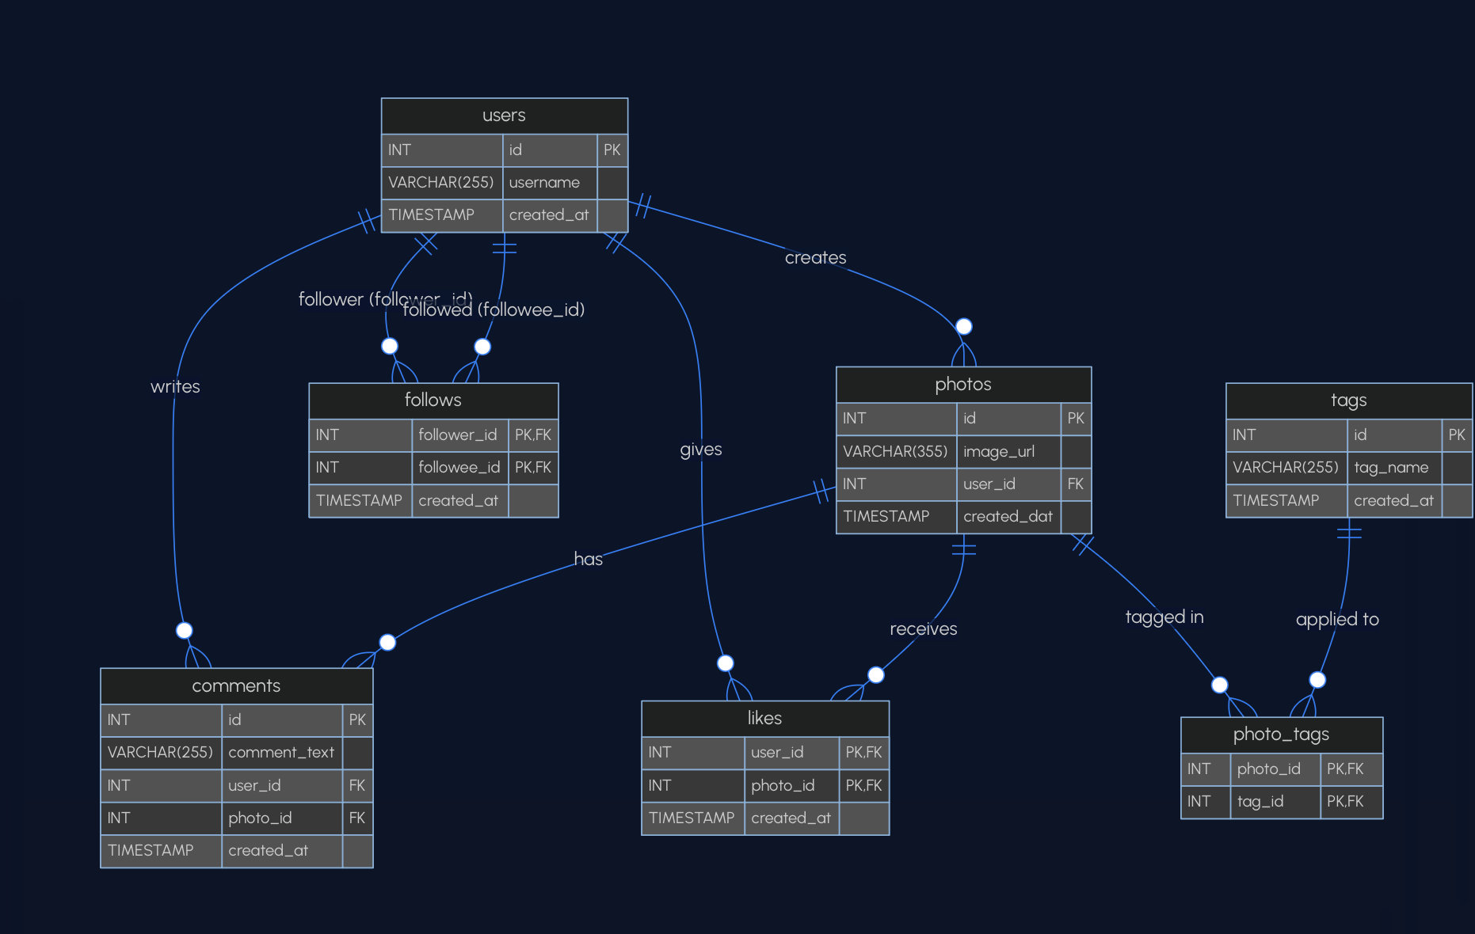
DATABASE SCHEMA
Caption

Slide 7
Analytics & Insights

Slide 8
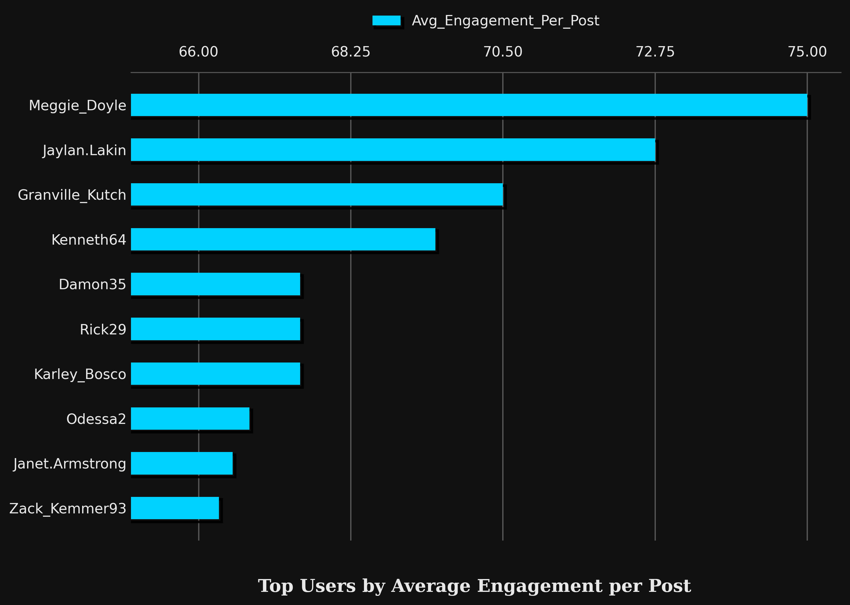
ACTIVITY LEVEL OF TOP USERS
Above chart shows top 10 users based on there engagement rate. Considering their posts, number of likes, numbers of comments they have received.
It is helpful in selecting the influencer or the brand ambassador for promotions.

Slide 9
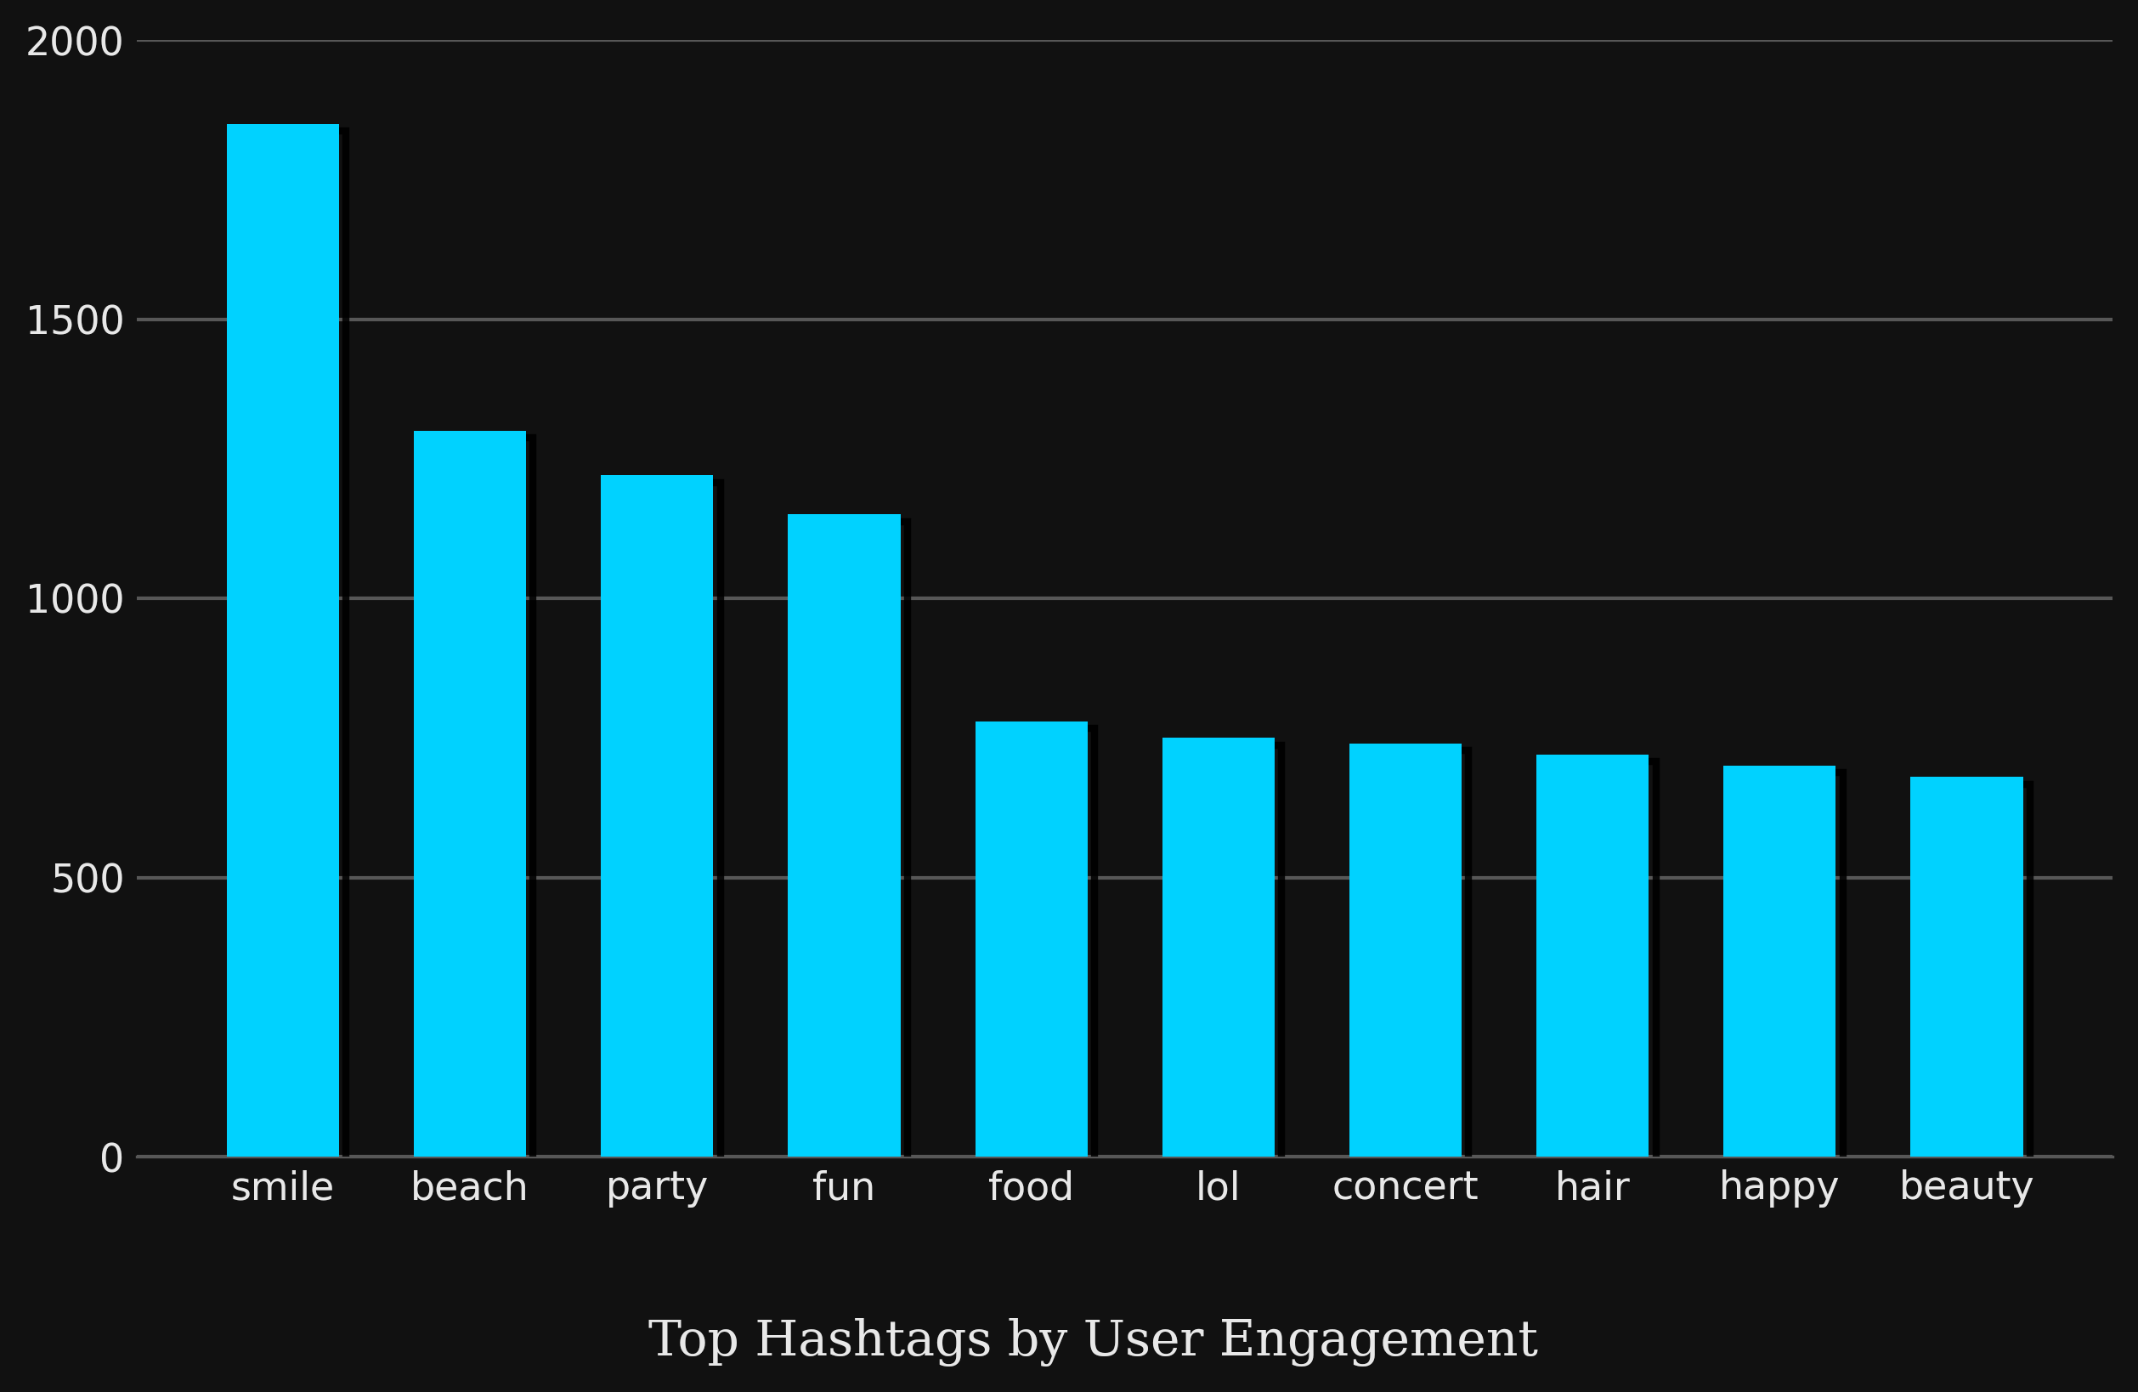
TOP HASHTAGS BY USER ENGAGEMENT
The chart shows Top 10 hashtags on bases of total engagement
It helps influencers to make their content reach large number of audience
This insight will help guide hashtag selection for ad campaigns, ensuring alignment with audience preferences and maximising engagement potential

Slide 10
Average Number of Tags Per Post
2.64
On average each Instagram post contains approximately 3 hashtags, suggesting that users rely on hashtags to improve content visibility

Slide 11
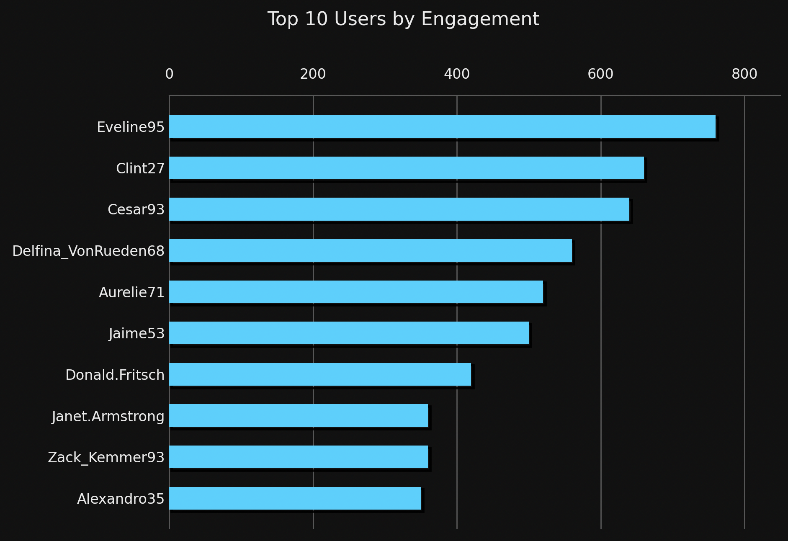
USER ENGAGEMENT RATE
Top 10 users on bases of numer of users they attract to maintain platform activity
Engagement rate helps pinpoint high-engagement users for collaborations, ensuring campaigns are more impactful and reach active followers

Slide 12
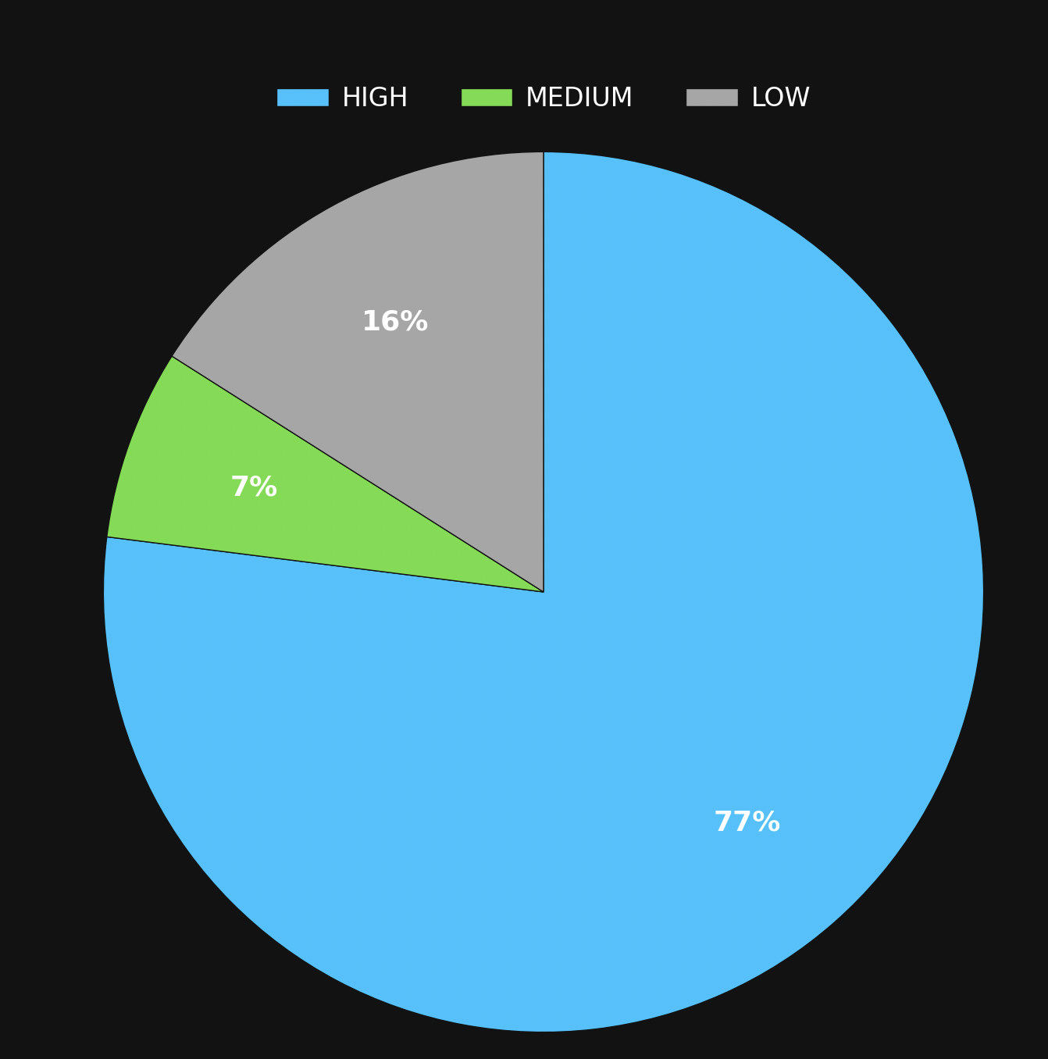
USER ACTIVITY LEVEL DISTRIBUTION
There are total of 26 Users who come under Medium and Low levels of activity on the plaform on whom we need to focus more causing a potential retension issue

Slide 13
Recomendations
Content Theming
Reward System
Leverage "Lifestyle" themes like Smile, Beach, and Food which show the highest engagement metrics in tag distribution.
Users earn points, badges, or exclusive platform benefits based on consistent activity and engagement by this we can attract Inactive users
#
Creator Partnerships
Hashtag Strategy
Prioritize collaborations with high-engagement users over high-following but low-engagement accounts.
Integrate AI-powered hashtag recommendations during post creation to optimize for high-performing tags and offer better engagement.

Slide 14
CONCLUSION
Content centered around high-engagement lifestyle themes such as "Smile, Beach, Party, Fun, and Food” resonates exceptionally well with the Meta community, making it ideal for both organic content strategies and targeted ad campaigns. Incorporating top-performing, aesthetic hashtags (#Dreamy, #Stunning, #Photography, and #Beauty) will further enhance visibility and maximize average likes per post. Collaborating with high-impact influencers like Meggie_Doyle and Jaylan.Lakin, alongside consistent creators like Janet.Armstrong, will amplify reach authentically, as their strong follower interactions drive credibility. Finally, implementing targeted retention incentives such as personalized push notifications, exclusive stickers, and reward-based programs will successfully re-engage the low-activity user segment and motivate dormant accounts to participate more frequently.

Slide 15

THANK YOU

